Slide 1


East West College of Engineering
[ Approved by AICTE, New Delhi, Affiliated to Visvesvaraya Technological University, Belagavi, Recognized by Government of Karnataka ]
BACHELOR OF ENGINEERING
In
AERONAUTICAL ENGINEERING
SECOND REVIEW
Subject Code: BAE785
14/08/2026
“Buckling Optimization of Stiffened Rocket Launch Vehicle Cylindrical Structures Considering Imperfection Sensitivity and Knockdown Factors”
SUBMITTED BY
K MAHESH 1EE23AE015
LOHITH KUMAR C S 1EE23AE021
NAVEEN H 1EE23AE030
PRAJWAL D T 1EE23AE036
GUIDE
Prof. PRABHU JADHAV
Department of Aeronautical Engineering
East West College of Engineering, Bangalore-64

Slide 2
Contents
Second Review
Introduction
Abstract
Objectives
Literature Survey
Methodology
Design of the model

Slide 3
Introduction
Rocket structures are designed to be extremely lightweight to maximize payload efficiency. This makes their cylindrical shells thin-walled and highly susceptible to buckling under compressive loads. Even small imperfections from manufacturing or assembly can drastically reduce their load-carrying capacity.
Classical shell theory predicts high buckling loads for perfect cylinders, but real-world rockets rarely achieve these values. Imperfections such as weld seams, thickness variations, and residual stresses lower the actual buckling strength. To ensure safety, engineers apply knockdown factors (KDFs)—conservative margins that reduce theoretical loads to practical design values.
By studying imperfection sensitivity and refining knockdown factors, engineers can design rocket cylinders that are both safe and lighter. This optimization reduces unnecessary structural mass, increases payload capacity, and improves overall launch vehicle performance.
This project explores how considering imperfections and applying modernized knockdown factors can increase buckling resistance in rocket cylinders. The goal is to bridge the gap between theory and practice, enabling the next generation of rockets to be stronger, lighter, and more reliable.

Slide 4
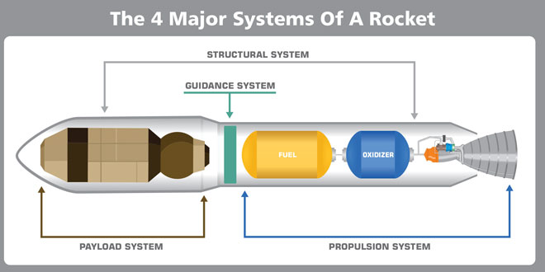
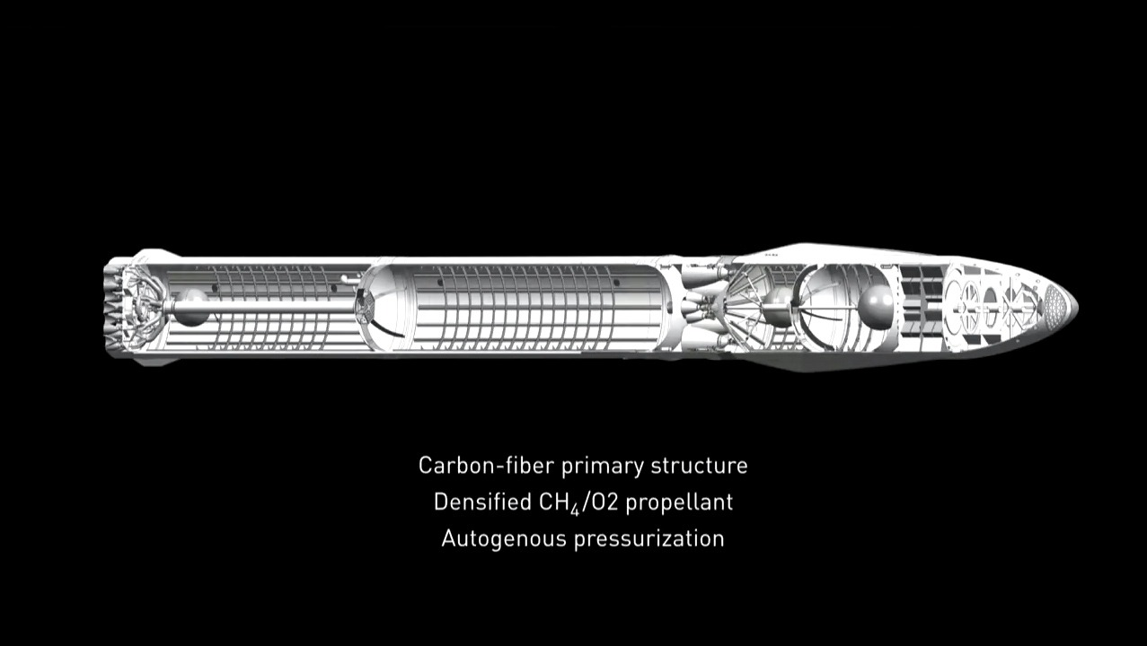
Fig:1 ROCKET INTERNAL STRUCTURE
Fig:2 ORTHOGRID INTERNAL STRUCTURE

Slide 5
Abstract
This work presents an integrated approach to the design, structural analysis, and experimental fabrication of pressurized launch vehicle airframes aimed at enhancing buckling resistance and maintaining global structural integrity under combined axial, bending, and internal pressure loads. By using first-order shear deformation theory and nonlinear finite element analysis (FEA), critical buckling modes—including global Euler buckling and pressure-induced wrinkling—which we will systematically evaluate. Our Parametric studies will identify optimal wall thickness distribution ,circular frames, and internal pressurization levels that maximize the buckling load margin while minimizing mass penalty. So, we will be using composite materials and separate pressurization chamber followed by full scale model analysis using axial compression testing.
Keywords: Buckling, Pressurization chamber ,Axial compression ,Stiffener grid.

Slide 6
Objectives
  Repeated use of launch vehicles.
  Reduction of buckling stresses or loads.
  To ensure long-term structural integrity.
  To prevent local skin deformation and wrinkling.

Slide 7
LITERATURE SURVEY
TITLE AND AUTHOR NAME | CONTENTS | INFERENCE
Title: Derivation of Buckling Knockdown Factors for Pressurized Orthogrid-Stiffened Cylinders of Launch Vehicle Structures Authors: Chang-Hoon Sim, Do-Young Kim ,Jae-Sang Park . Publisher : Springer | Postbuckling analyses are conducted to derive knockdown factors (KDFs) for pressurized orthogrid-stiffened cylinders used in launch vehicles. Explains the importance of KDFs in accounting for imperfections in thin-walled cylinders. Reviews NASA’s historical buckling criteria (SP-8007) and modern projects (SBKF, DESICOS). Highlights the lack of criteria for pressurized cylinders. Imperfection modeling techniques: SPLA (geometric imperfections only) and SBPA (geometric + loading imperfections). SPLA vs SBPA comparison shows SBPA yields conservative KDFs, better aligned with experimental results. | Internal pressure strengthens thin-walled cylinders against buckling, enabling more efficient lightweight designs. SBPA should be favored in design practice because it captures both geometric and loading imperfections, ensuring safety margins while avoiding unnecessary weight penalties. Traditional NASA criteria are overly conservative and don’t account for modern materials or pressurization effects.

Slide 8
LITERATURE SURVEY
TITLE AND AUTHOR NAME | CONTENTS | INFERENCE
Title: Test and Analysis of Full-Scale 27.5-Foot-Diameter Stiffened Metallic Launch Vehicle Cylinders. Authors: SAndrew E. Lovejoy , Mark W. Hilburger, Nathaniel W. Gardner. Publisher: American Institute of Aeronautics and Astronautics (AIAA). | This paper presents the testing and analysis of two full-scale, 27.5-foot-diameter, stiffened metallic cylinders made from aluminum-lithium 2195 alloy. Conducted under NASA’s Shell Buckling Knockdown Factor Project, the study aimed to validate improved buckling design factors for modern launch vehicles. Finite element models (FEM) developed using Abaqus software. Assumed nominal geometry and material properties. Comparison of test vs. analysis for ETTA1 and ETTA2. Discrepancies observed, especially in weld land regions. Sensitivity studies showed local skin pocket buckling and residual stresses significantly affect predictions. | Simplified FEMs can predict overall response trends but fail to capture localized effects. Manufacturing imperfections (weld lands, residual stresses) play a critical role in buckling behavior. Scaling from subscale to full-scale introduces complexities that must be accounted for in design. Updated knockdown factors (KDFs) are necessary to ensure safe yet efficient launch vehicle designs.
8

Slide 9
LITERATURE SURVEY
TITLE AND AUTHOR NAME | CONTENTS | INFERENCE
Title: Buckling design optimization of tow-steered composite panels and cylindrical shells considering aleatory and epistemic uncertainties. Authors: Marc Fina (Karlsruhe Institute of Technology, KIT) and Chiara Bisagni (Politecnico di Milano, TU Delft) Publisher: springer | VAT composites: Advanced fiber placement techniques allow spatially varying fiber orientations, improving buckling resistance and reducing imperfection sensitivity compared to classical composites. Geometric imperfections: Modeled as random fields and Fourier series to capture imperfection sensitivity. Optimization framework: Multi-objective optimization using surrogate models (artificial neural networks) to balance robustness (minimizing variation of buckling loads) and performance (maximizing mean buckling loads). Experimental validation: Geometric imperfection measurements of VAT cylindrical shells support the modeling approach | The authors argue that deterministic optimization is insufficient for real-world aerospace structures, as manufacturing processes introduce unavoidable uncertainties. By combining aleatory and epistemic models, they propose a polymorphic uncertainty framework that better reflects reality. This approach shows that VAT composites can be designed to be both high-performing and less sensitive to imperfections, but trade-offs must be carefully managed

Slide 10
LITERATURE SURVEY
TITLE AND AUTHOR NAME | CONTENTS | INFERENCE
Title: Buckling Behavior of Thin-Walled Cylindrical Shell Structure Under Axial Compression: A Study of Imperfection Parameters with FE Approach Authors:Aryanda Rakhmad Maharditya, Ben Ganendra Publisher: Springer | Thin-walled cylindrical shells are widely used in aircraft, ships, and tanks because of their high strength-to-weight ratio. However, they are very sensitive to buckling failure, especially when imperfections exist. Three cylindrical models were tested: DT240-F ,DT200-F ,DT171-F The research studied three main imperfections: Load eccentricity Initial geometric imperfections Thickness imperfections. Load eccentricity reduces the ultimate load capacity. Imperfections cause earlier buckling failure. Deformation pattern changes when load position shifts. | The study concludes that imperfections such as load eccentricity, thickness variation, and geometric deviations significantly reduce the buckling strength of thin-walled cylindrical shells. Imperfections must be included in structural design. Finite element analysis can accurately predict buckling behavior. Considering these factors improves safety and reliability of cylindrical shell structures used in aerospace and marine engineering.

Slide 11
LITERATURE SURVEY
TITLE AND AUTHOR NAME | CONTENTS | INFERENCE
Title: Buckling Behavior of Double-Layered Composite Cylindrical Shells Authors:Mahyar Maali,Baris Bayrak Publisher: Elsevier Ltd. | The study aims to investigate: Buckling and post-buckling behavior of cylindrical shells and Effect of different composite materials on buckling resistance. Seven thin-walled cylindrical shell specimens were tested under hydrostatic pressure, Key parameters of the cylindrical shells: Height = 800 mm Thickness = 0.45 mm Steel material = S355 galvanized steel Buckling was tested using: Hydrostatic pressure loading The results showed: Composite materials significantly increase buckling resistance. And Double-layer CFRP provided the highest buckling load. Using polypropylene between two cylinders improved buckling load more than waste polymer. | Composite materials increase buckling load of cylindrical shells significantly. Double-layer CFRP reinforcement provides the highest buckling strength. Polypropylene between two cylinders also improves structural stability. Experimental buckling loads were higher than theoretical predictions, meaning design codes may underestimate real capacity. Using composite materials improves load carrying capacity and post-buckling behavior of cylindrical shells.

Slide 12
LITERATURE SURVEY
TITLE AND AUTHOR NAME | CONTENTS | INFERENCE
Title: Nonlinear Buckling and Post buckling Analysis of Tow-Steered Composite Cylinders with Cutouts Authors: Rainer M.J. Groh K. Chauncey Wu Publisher: Elsevier Ltd. | Two shells manufactured using Automated Fiber Placement (AFP). Shell A: thickness variations due to tow overlaps. Shell B: uniform thickness using tow drop/add capability. Axial compression tests on pristine shells, then shells with small cutouts (passenger door size) and large cutouts (cargo door size). Nonlinear FE models in ABAQUS reproduced pre buckling stiffness, buckling loads, and post buckling behavior. Buckling load of shells with cutouts remained at least 82% of pristine shell capacity. | Tow steering is highly effective in reducing the adverse effects of cutouts in composite cylinders. Even with large cutouts, structural performance remained close to pristine shells due to favorable load redistribution. This approach offers a lightweight alternative to traditional reinforcement, with strong potential for future aircraft fuselage and launch vehicle design. Nonlinear FE analysis validated experimental results, showing accurate prediction of pre buckling, buckling, and post buckling responses.

Slide 13
LITERATURE SURVEY
TITLE AND AUTHOR NAME | CONTENTS | INFERENCE
Title: Buckling of Axially Compressed Composite Cylinders with Geometric Imperfections Authors: Fathollah Taheri-Behrooz , Milad Omidi . Publisher: Steel and Composite Structures Journal | Composite cylinders require updated methods that account for orthotropic properties and imperfections. Imperfections from manufacturing and handling are critical in reducing buckling loads. Need for refined methods for composite cylinders with cutouts. Comparison: LBMI more conservative, SPLI slightly higher predicted loads. Small cutouts → imperfections significantly reduce buckling load. Large cutouts → cutout effect dominates, imperfections less influential. Increasing cutout number reduces buckling load more at small cutout sizes. Knockdown factors: LBMI (0.62), SPLI (0.64), NASA SP-8007 (0.54). | Geometric imperfections drastically reduce buckling capacity, especially in cylinders with small cutouts. For large cutouts, the cutout itself governs failure, not imperfections. Modified LBMI provides a probabilistic, more realistic approach compared to classical LBMI. SPLI and M-LBMI methods yield similar results, both less conservative than NASA SP-8007. Updated imperfection-sensitive design methods are essential for composite aerospace structures to avoid over-conservatism and unnecessary weight
13

Slide 14
LITERATURE SURVEY
TITLE AND AUTHOR NAME | CONTENTS | INFERENCE
Title: Evolution in Manufacturing of Grid Stiffened Structures through CAM and Additive Techniques. Authors:Dr. A.K. Madan, Kshitij Tripathi Publisher: IAEME Publication (Scopus Indexed Journal) | Grid stiffened structures like isogrid and orthogrid help improve strength while reducing weight. Isogrid is a triangular rib lattice structure.Provides: High stiffness,High strength-to-weight ratio ,Better load distribution. Used in: Rocket shells ,Satellite structures ,Aircraft components. ManufacturingTechniques Conventional methods, Unconventional methods Role of Additive Manufacturing,3D printing allows:Manufacturing complex, isogrid structures ,Reduced assembly requirement ,Faster prototyping. The study compares manufacturing techniques based on: Ease of manufacturing, Structural performance, Cost and efficiency ,Material selection and processing constraints. | Grid stiffened structures (especially isogrids) are highly efficient lightweight structures used in aerospace applications. Conventional manufacturing methods have several limitations. Unconventional methods such as abrasive water jet machining and additive manufacturing provide better quality, flexibility, and cost efficiency. Future aerospace structures will increasingly rely on additive manufacturing and composite materials for improved performance and weight reduction.

Slide 15
LITERATURE SURVEY
TITLE AND AUTHOR NAME | CONTENTS | INFERENCE
Title: Advances in Lightweighting Strategies for Aerospace: Materials, Structures, and Fuel Innovations. Author: Tanay Dash Publisher : ajosr organisation | Material Innovations Examines alloys composites and polymers which are advanced solutions for lightweight structures. Structural Optimization Discusses fuselage designs such as circular fuselages (hoop tension) and hybrid wing-body structures. Introduces ribbed shells, honeycomb structures, and sandwich shells to balance strength and weight. | The paper shows that lightweighting is a holistic aerospace strategy combining materials, structures, and fuel systems. Each approach individually offers benefits, but together they create a synergistic effect that enhances performance, reduces environmental impact, and lowers costs. The inference is that future aerospace progress will rely on the integration of multiple lightweighting strategies to achieve sustainable, efficient, and advanced flight

Slide 16
LITERATURE SURVEY
TITLE AND AUTHOR NAME | CONTENTS | INFERENCE
Title: Test and Analysis of Buckling-Critical Stiffened Metallic Launch Vehicle Cylinder. Authors : Mark W. Hilburger, Michael C. Lindell, W. Allen Waters, Nathaniel W. Gardner. Publisher: American Institute of Aeronautics and Astronautics (AIAA) | Subscale cylinders: 8-ft diameter, 6.5-ft length.. Constructed from Al-Li 2195 panels with orthogrid and isogrid stiffener patterns. Weld land designs: tapered stiffener (TS) and picture frame (PF). Finite element models developed using Abaqus. Included load introduction structures, attachment rings, and measured imperfections. Used shell elements for skin/stiffeners, beam elements for load lines. Material properties: Al-Li 2195 assumed isotropic, linear elastic. Analyses included nonlinear static and dynamic simulations to capture prebuckling and postbuckling behavior. Buckling occurred at ~647 kips, followed by collapse and load reduction to ~312 kips. which reduced its load carrying capacity by 50% after buckling. | Buckling behavior of stiffened metallic cylinders is highly sensitive to geometric imperfections and weld land details. Simplified models provide initial predictions but require refinement to match experimental data. Updated knockdown factors must incorporate manufacturing realities and imperfection effects. The SBKF program is crucial for modernizing NASA’s design guidelines for launch vehicle structures.
16

Slide 17
Methodology
Problem Identification
Literature survey
Design of the model
Ansys
Prototyping
Evaluation of results

Slide 18
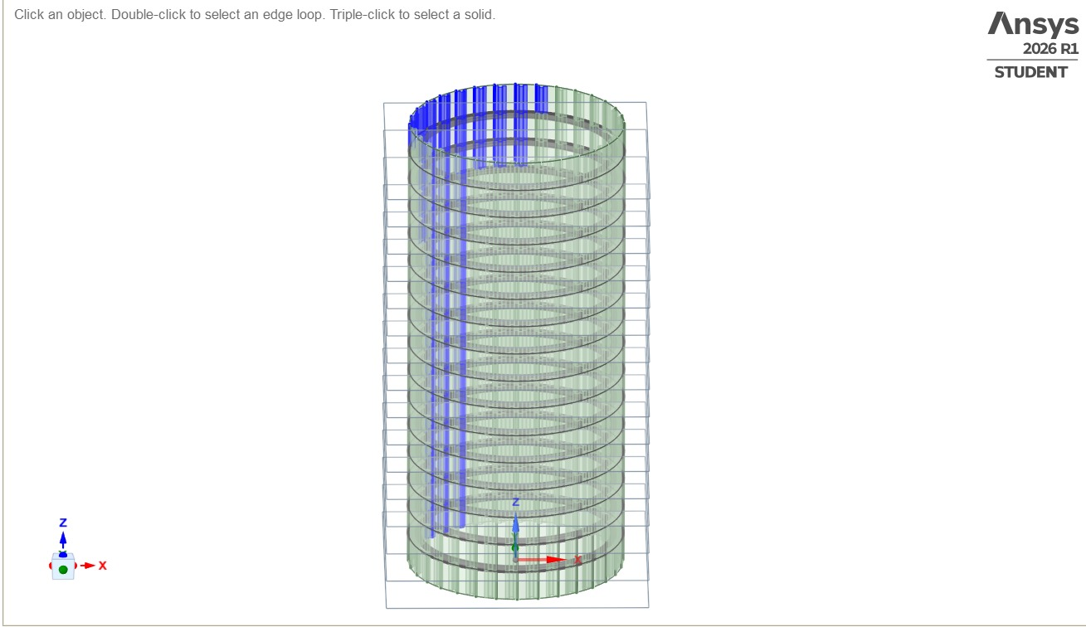
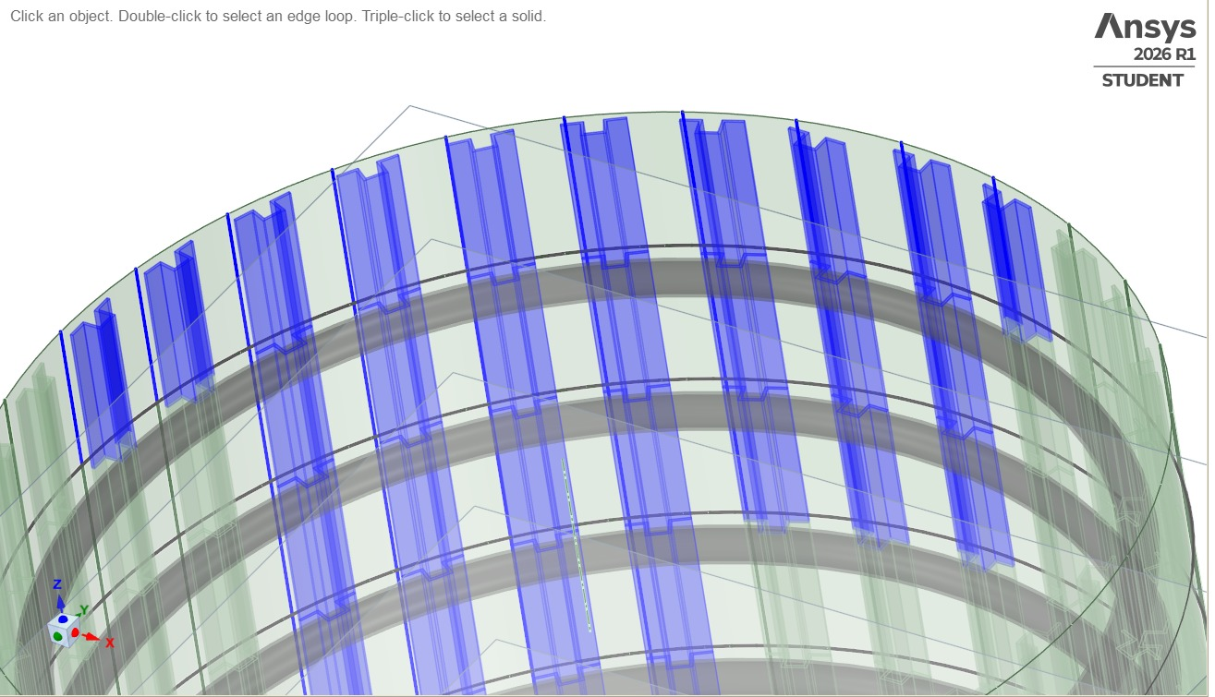
Design of the model
Fig 1: Front View | Fig 2: Isometric View
The figure shows a cylindrical rocket structure modeled in ANSYS 2026 R1 Student Edition, based on the Falcon 9 design. The model includes blue vertical stiffeners and green circular rings that strengthen the shell and help resist buckling under load. This setup represents the reinforced composite cylinder used in rockets to improve stability and load distribution during launch.

Slide 19
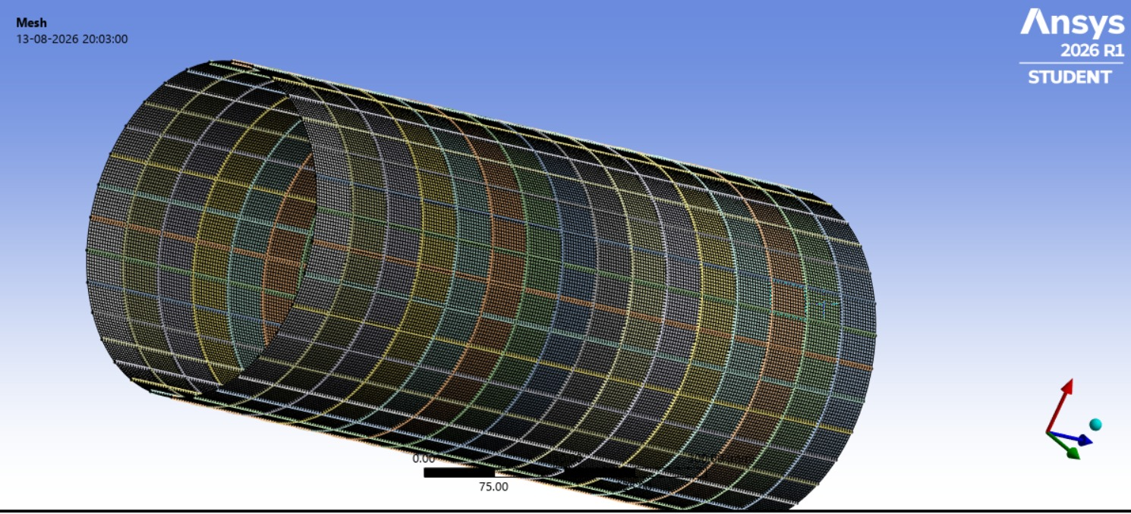
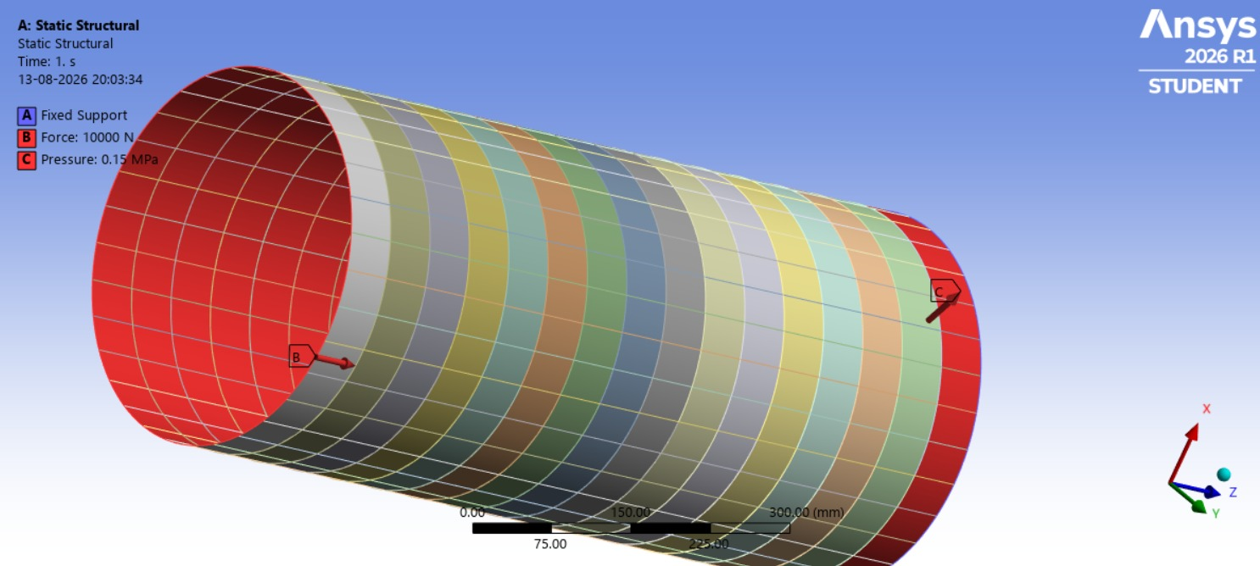
Meshing and boundary conditions
Fig 3: Meshed cylindrical model
Fig 4: Boundary conditions and loading setup

Slide 20
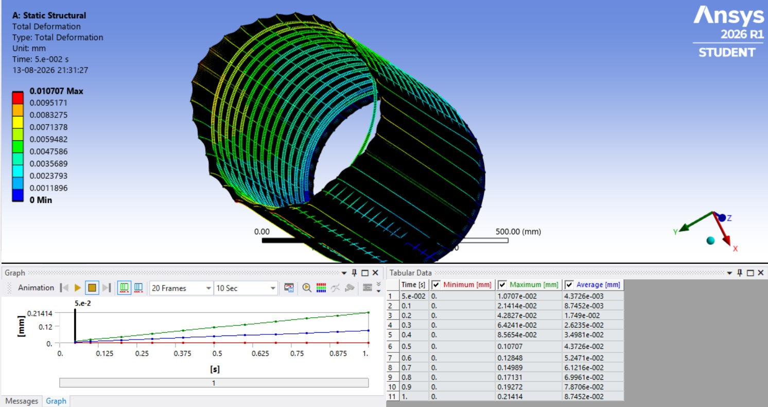
Results and Graphs
The figure shows the total deformation of the stiffened rocket cylinder under static structural analysis. The maximum deformation recorded is 0.010707 mm, indicating minimal displacement and confirming the model’s high stiffness and structural stability under applied loads.

Slide 21
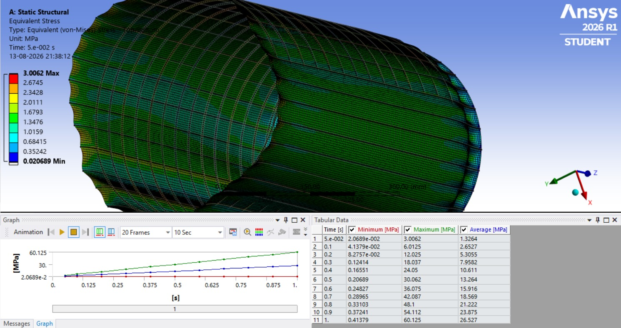

Slide 23

Any Questions

Slide 24
THANK YOU

